Slide 1
Writing Effective LEPs May 4, 2021

Slide 2
Introduction
Trainer-
Dr. Maureen Hogan
Atlas Training, Inc.
Program Director
and Principal Trainer
- Committed to comprehensive training across all levels of the early childhood workforce.

Slide 3
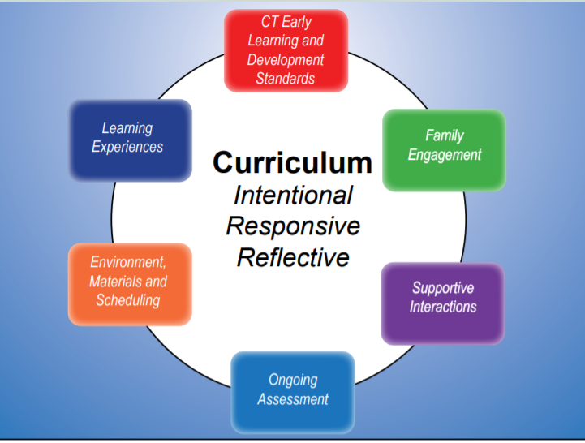
Creating Effective Learning Experience Plans
-See template.
https://www.ctoec.org/wp-content/uploads/2020/01/CT-ELDS-Supplement-Meaningful-Curriculum.pdf

Slide 4
Poll Time!
What is your current role?
On a scale of 1-5, rate your comfort with writing learning experience plans (1= Not comfortable at all ; 5= Extremely confident in my ability to write high-quality LEPs)
What aspects of writing learning experience plans do you find most challenging? (Select all that apply)

Slide 5
Purpose
The purpose of this workshop is to support teachers in understanding how to plan curriculum and to write effective, robust, and comprehensive learning experience plans that meet the needs of your learners.
Notes:
This workshop will not focus on implementation but will focus on plans.
Implementation CAN happen when you write and learn how to follow effective plans!!!
Stay tuned for more workshops on curriculum!!!

Slide 6
Objectives
To develop a joint understanding of what meaningful curriculum is.
To understand what teachers need to do to ensure that their curriculum is meaningful.
To understand the components of effective lesson plans
To apply new knowledge to write an effective plan

Slide 7
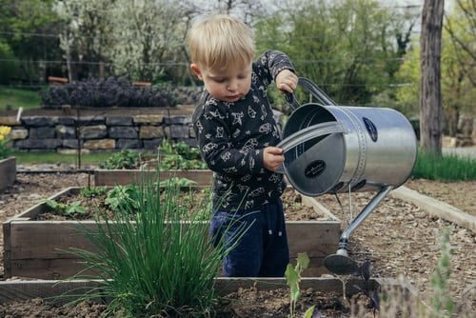
What is Meaningful Curriculum?
In the chat box, take a minute to enter in any ideas or words you may have to describe what it means to utilize a meaningful curriculum.

Slide 8
Definition of Meaningful Curriculum
Experiences that connect to the lives of children…
their interests as well as their cultural backgrounds.
Experiences are of interest to the children.
Allow children to engage actively in the learning process.

Slide 9
Components of a Meaningful Curriculum
“Content to be included in integrated learning experiences may stem from specific CT ELDS in the areas of science or social studies, but must also incorporate children’s interests and be presented in a context that stimulates children to become actively and purposefully engaged in their work. A curriculum that is implemented in a responsive manner incorporates the interests of the particular children in a group and flexible about the length of time spent on projects or units of study. When children continue to be engaged and interested, units of study may last for weeks or months, with adults introducing new materials and/or prompts to extend learning and exploration. Children need to interact with the curriculum – to explore it, question it, and evaluate it in their own way of learning. Children’s active engagement ensures purposeful and sustained learning. Learning takes time!”
- CT Office of Early Childhood
Notes:
This should look differently… integrate into PPT…

Slide 10
Meaningful Curriculum
Teachers need to be:
Intentional: All aspects of the curriculum are purposeful and planned with specific goals in mind
Responsive: Program and staff respond to the changing social-emotional, academic, physical, and cultural needs of the children and families served.
Reflective: Staff engages in ongoing, thoughtful consideration and change to best meet the needs of the children and families.

Slide 11
Example 1: Camping
Ms. Sherise has prepared a new unit on camping. She found some books at the library on camping and she thinks the children will enjoy learning about what it is like to camp and to sleep outdoors. She explains to the children that she has added some new materials to the dramatic play center (ie… a tent, a compass, and outdoor cooking utensils) for the children to pretend play that they are going camping. The children have never been camping before.

Slide 12
Questions
Is this meaningful for children? Why or why not?
Who is doing the thinking?
What do we know and what do we not know?
What can we do to make this more meaningful?

Slide 13
Components to Consider
CT ELDS
Learning Experiences
Interactions
Family Engagement
Environments, Materials, Scheduling
Assessment
Question to consider: Does the actual format of the plan you use address all six of these components?

Slide 14
Example 2: Camping
Ms. Sherise has prepared a new unit on camping. The children have never been camping but she has been reading some stories to the children to introduce them to the idea of camping. She has considered the individual needs of her learners and she knows that a few of the children could benefit from using their creativity in learning how to design a tent. She also thinks that this may be a good time to introduce the children to new vocabulary that might be used when camping, such as ‘bonfire’, ‘canteen’, ‘compass’, grizzly bear’, ‘hammock’, ‘hike’, ‘lantern’, ‘sleeping bag’, ‘stake’, ‘tent’, ‘trail’.
She uses the ELDS to determine which standards she will want to work with for this new unit.
She reflects on how she can get the families involved.
She considers the types of experiences she wants to provide to the children that will allow them to do most of the thinking.
She considers what her role will be in supporting the children in learning as much as they can about the new topic.
She considers how she will assess the children’s learning.
She considers the timeframe she will have to work with the children on this unit, her classroom opportunities and advantages, and the schedule (environment, materials, schedule)

Slide 15
Questions
Questions:
How do we know that this is meaningful for the children?
Do you find that the initial plan considered ALL six of the components to building meaningful curriculum?
… If so, you are ready to move on. If not, then you would want to stop to do more brainstorming with your team.

Slide 16
Sample
COGNITION
Strand A: Early learning experiences will support children to develop effective approaches to learning
Strand A: Cooperation with Peers in Learning Environments
Experience | Interactions | Assessment
Description of Learning Experience: | Recommended Teaching Strategies:
Learning Objectives: | DUAL – LANGUAGE LEARNERS: STRAND: Choose an item. PROGRESSION: Choose an item.
 | IEP/IFSP Connections:
CT ELDS
Learning Experiences
Interactions
Assessment
Family Engagement
Environments,
Materials, Scheduling
Family Engagement Strategies:
Environment and Materials:

Slide 17
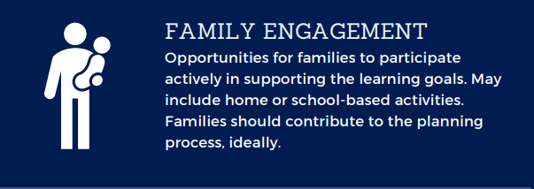
Writing the Plan!

Slide 18
Writing the Plan: Standards
Target CT ELD Standards specified and include:
Standard/Content Area
Strand
Progressions
Multiple standards occurring at once (do not occur in isolation)

Slide 19
Writing the Plan: Learning Experiences
Multiple Environments
Different group types
Connected to children’s experiences/backgrounds
Multi-modal
Play-Based

Slide 20
Writing the Plan: Interactions
Intentional strategies to promote student development
Higher Order Thinking questions
Address dual-language learner needs
Address IEP goals
Address children’s behavioral/emotional needs
ACTIVE MINDSET

Slide 21
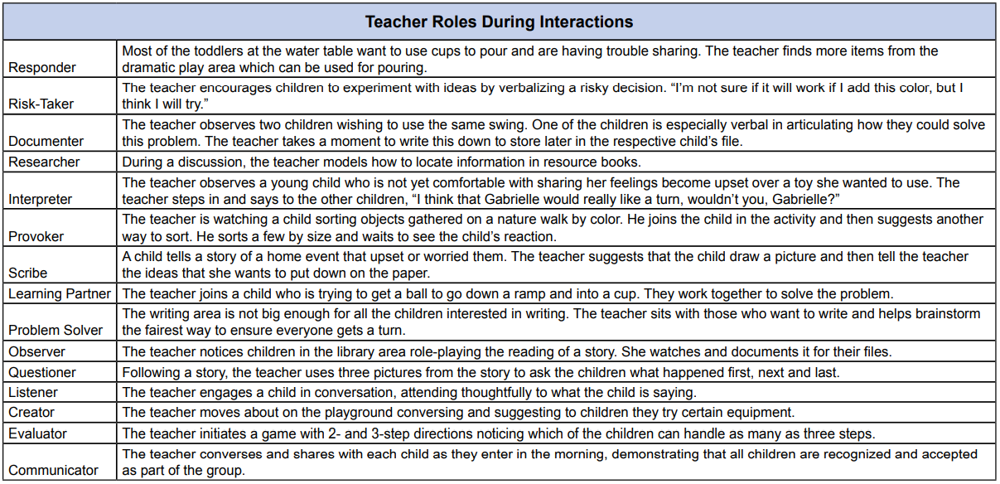
Writing the Plan: Interactions (cont.)

Slide 22
Writing the Plan: Interactions (cont.)
To support student learning, the teacher will….
Respond to student actions by commenting on or describing what they are doing
Ask questions to provoke analysis of the task
Prompt problem solving
Restate student utterances to demonstrate listening and understanding
Model how to use materials, including unsuccessful task attempts
Document children’s work in a variety of formats (i.e. pictures, videos, narrative descriptions) and review documentation with child and families

Slide 23
Writing the Plan: Family Engagement
Contribute to development of plans
Contribute to assessment process
Have opportunities both in the classroom and at home to support children’s success

Slide 24
Writing the Plan: Environments, Materials, Scheduling
New materials
Environment modifications
List of supplies
Planning for schedule adjustments

Slide 25
Writing the Plan: Assessment
In students’ primary languages
Collect accurate data
Describe assessment tools/instruments to be used

Slide 26
Sample
COGNITION
Strand B: Early learning experiences will support children to use logic and reasoning.
Strand B: Problem Solving
Activity Description | Recommended Teaching Strategies | Assessment Strategies
Moving Water:
Learning Objectives: Children will explore properties of matter and will experiment with a variety of tools | Individualizations/Modifications
 | DUAL – LANGUAGE LEARNERS: STRAND: PROGRESSION:
 | IEP/IFSP Connections:
Family Engagement Strategies:
Materials:
hmhghm

Slide 27
Contact Us
Website: www.atlastrainingcenter.com
Email: ewilson@atlastrainingcenter.com
mhogan@atlastrainingcenter.com
Phone: 860-788-3546

